Slide 1


Porting from .NET Framework
Speaker Name
Notes:
Welcome to .NET Workshop. In this overview session, I would like to set the stage for this workshop with the current landscape on how to build apps with .NET

Slide 2
When Should You Port To .NET 6
Need .NET 6 Features (e.g. Cross-Platform)
New Project
Able to Upgrade Individual Component / Service

Slide 3
When Shouldn’t You Port To .NET Core
Working Code, No Compelling Business Reason
Need Features Not In .NET 6 (Pretty Few Now)

Slide 4
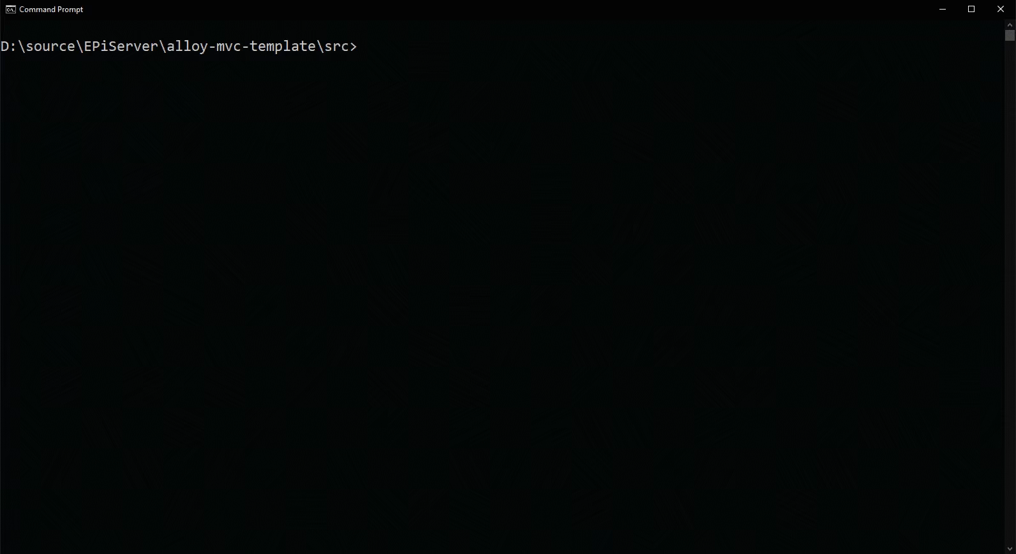
.NET Upgrade Assistant
Notes:
Guided step-by-step experience
Support of multiple project types
ASP.NET MVC
Windows Forms
Windows Presentation Foundation (WPF)
Console
Libraries
Extensible Model
Add default functionality to the experience
Great if you have lots of apps to migrate
Open Source

Slide 5
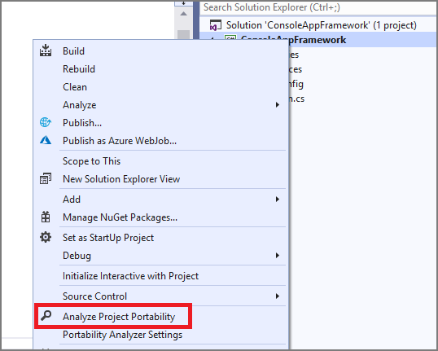
.NET Portability Analyzer
Notes:
.NET Portability Analyzer
Visual Studio Extension or CLI
Open Source on GitHub
Currently not available in VS 2022

Slide 6
Demo: Porting a Library

Slide 7
ASP.NET Considerations
Modules / Handlers
Startup / Configuration
Front-end (static) files
Identity
Entity Framework (migrations, etc.)
Tool: Routing

Slide 8
Steps
Get ready
Learn with a new / internal application
Prepare Your Existing Application
Update to new release / patterns
Refactor to services
Test coverage (unit, integration, user interface)
Create a New Application
Select the nearest match
Copy / reference code

Slide 9
Lab: Porting an ASP.NET MVC Application
Notes:
Download Porting existing ASP.NET Apps to .NET Core e-book (PDF) (microsoft.com) Page 43

Slide 10
Useful Resources
Port from .NET Framework to .NET 5 - .NET Core | Microsoft Docs
https://github.com/dotnet/upgrade-assistant
Download Porting existing ASP.NET Apps to .NET Core e-book (PDF) (microsoft.com)

